Slide 1

Prompt Engineering (Talking to LLM) -Aravind Daram

Slide 2







Chat Interfaces
ChatGPT
Claude
Gemini
perplexity
Microsoft Copilot
Grok AI
DeepSeek

Slide 3



Voice Interfaces
Amazon Alexa
Apple Siri
Google Assistant

Slide 4
PERFECT Prompt Formula
Context
Specific information
Intent/Goal
Response Format

Slide 5
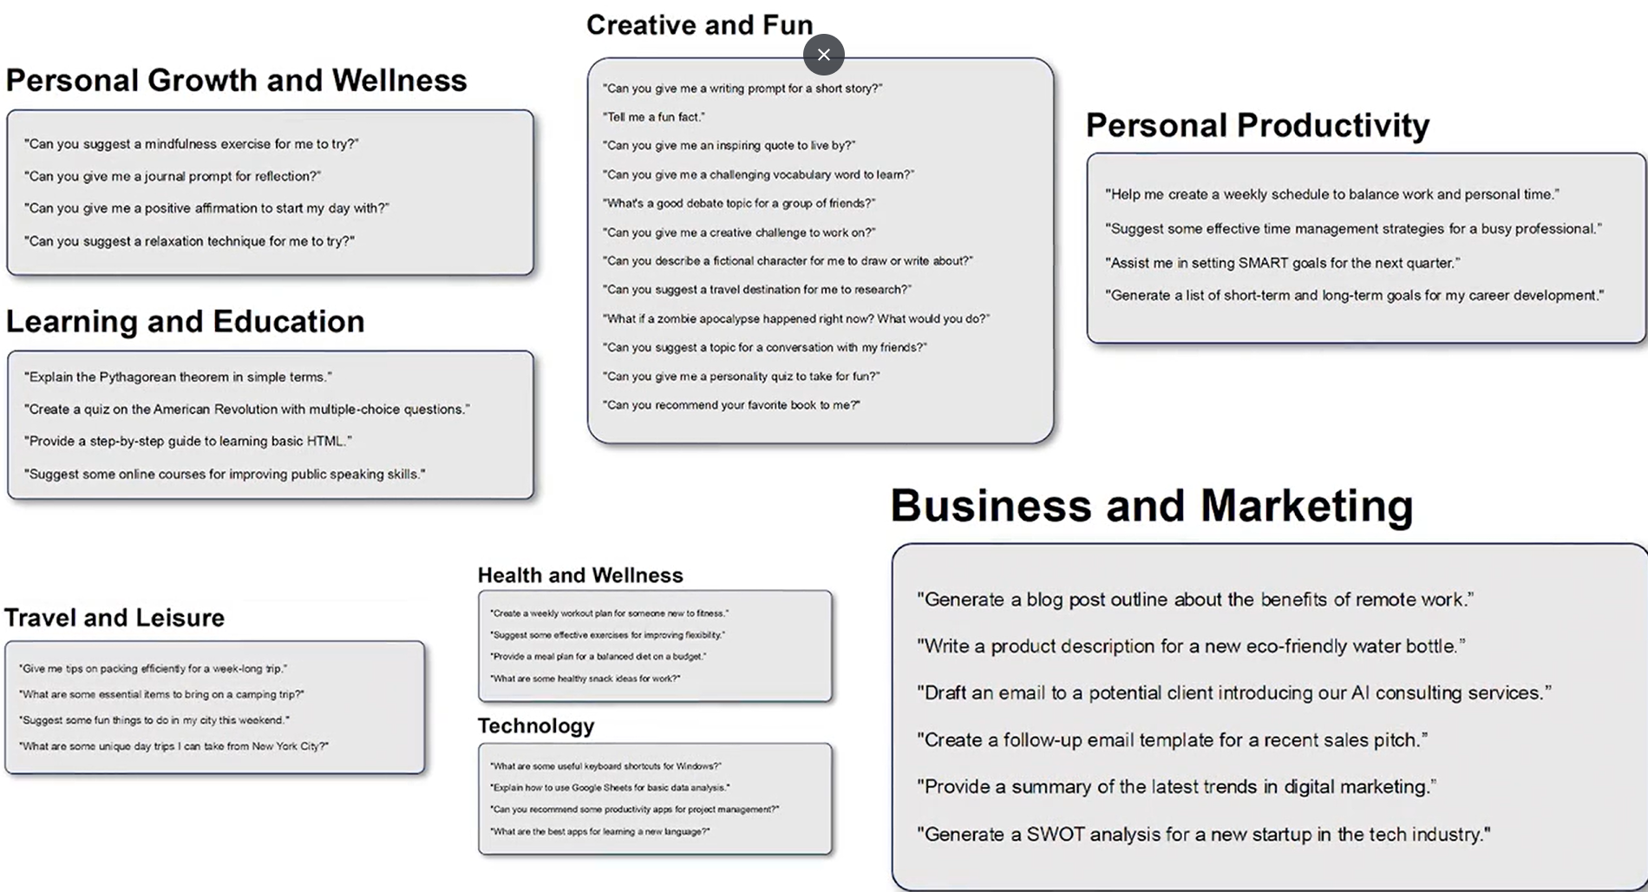

Slide 6
Prompt Engineering Techniques
Zero Shot Prompting
One-Shot Prompting
Few-Shot Prompting
Chain of Thought

Slide 7
Prompt Engineering Types
General knowledge Prompting – Example : In chess, can the king move two squares in any direction?
Instructional Prompting
Example : Please convert the following name into the format '[Last name], [First name]': John Smith
System Messages
Example: What can you tell me about me, Aravind Daram
Contextual Prompts
Example :You are a software engineer helping a junior developer understand how version control works.
Explain the concept of Git branches in a way that's easy for a beginner to understand. Include a simple real-world analogy.
Control codes
Example : "<|summarize|> The following article discusses the impact of climate change on polar bears..."

Slide 8

Use case time

Slide 9
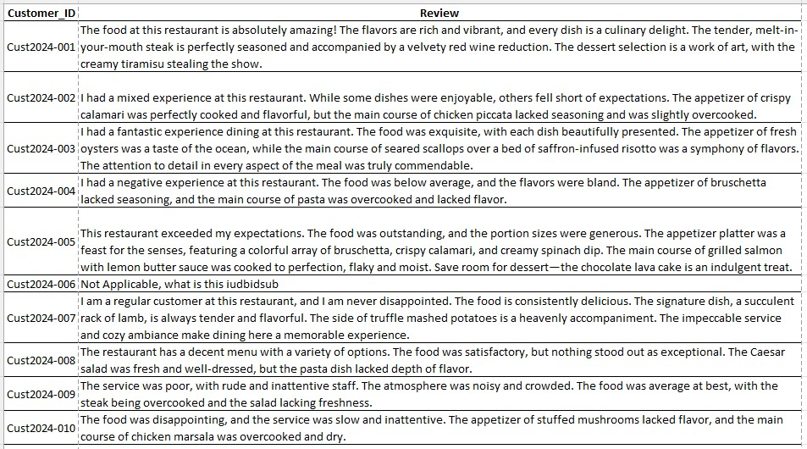
Customer reviews

Slide 10
Initial or system prompt
Hello! You are a Customer Review Analysis AI Assistant for a restaurant chain to analyze restaurant reviews and provide actionable insights.
Your task is to categorize reviews, identify critical aspects of the dining experience, prioritize feedback, suggest next steps and generate appropriate responses to enhance customer satisfaction.

Slide 11
Zero-shot prompting
Analyze the reviews from the attached screenshot as suggested in the initial prompt.
Format the generated information into a tabular layout including individual review

Slide 12
One-shot prompting
Here is an example on how to analyze a restaurant review. Based on this example, analyze the reviews again in the structured approach.
Example Review: The ambiance was relaxing and the staff were exceptionally friendly. However, the fish was slightly undercooked, which was disappointing.
Analysis:
Categorize Sentiment - Positive (positive comments on ambiance and staff outweigh the negative comment on the food).
Tags- Food Quality : Needs Improvement, Service : Excellent, Ambiance: Excellent, Price: Not mentioned and Overall Experience: Good
Priority: Normal (The issue mentioned does not require immediate drastic changes but should not be ignored).
Suggested Actions: Review cooking procedures with the kitchen staff to ensure all dishes meet the cooking standards.
Generated First Reply: 'Thank you for your valuable feedback. We’re thrilled you enjoyed our ambiance and service. We apologize for the issue with the fish dish and are addressing this with our kitchen team to ensure it meets our high standards in the future. We hope to welcome you back soon for a more flawless dining experience.’

Slide 13
Few-shot prompting
Below are examples of how to analyze restaurant reviews. After reviewing these examples, analyze the reviews again using the same structured approach:
Example 1:
Review: The ambiance was relaxing and the staff were exceptionally friendly. However, the fish was slightly undercooked, which was disappointing.
Analysis:
Categorize Sentiment - Positive (positive comments on ambiance and staff outweigh the negative comment on the food).
Tags- Food Quality : Needs Improvement, Service : Excellent, Ambiance: Excellent, Price: Not mentioned and Overall Experience: Good
Priority: Normal (The issue mentioned does not require immediate drastic changes but should not be ignored).
Suggested Actions: Review cooking procedures with the kitchen staff to ensure all dishes meet the cooking standards.
Generated First Reply: 'Thank you for your valuable feedback. We’re thrilled you enjoyed our ambiance and service. We apologize for the issue with the fish dish and are addressing this with our kitchen team to ensure it meets our high standards in the future. We hope to welcome you back soon for a more flawless dining experience.

Slide 14
Few-shot prompting
Example 2:
Review: The atmosphere was nice, but my pasta was overcooked and bland.
Analysis:
Categorize Sentiment - Negative.
Tags- Food Quality : Poor, Service : Not Mentioned, Ambiance: Good, Price: Not mentioned and Overall Experience: Average
Priority: High (Immediate action required to address food quality issues).
Suggested Actions: Check with the kitchen staff on the meal issue; enhance training if needed.
Generated First Reply: ‘We apologize for your recent experience at our restaurant. We’re looking into the matter and will ensure it doesn’t happen again. Please consider visiting us again so we can provide a better experience.’

Slide 15
Few-shot prompting
Example 3:
Review: Good prices and decent food but nothing exceptional.
Analysis:
Categorize Sentiment - Neutral.
Tags - Food Quality : Average, Service : Not Mentioned, Ambiance: Not Mentioned, Price: Good and Overall Experience: Average
Priority: Normal (Monitor and possible improve offerings subtly).
Suggested Actions: Explore new menu options to provide a more memorable dining experience.
Generated First Reply: ‘Thank you for your feedback. We’re glad you found our prices reasonable and are constantly looking to enhance our menu offerings.’

Slide 16
Chain-of-thought prompting
Initial Prompt: Analyze the reviews again by following these steps:
Prompt 1 : Identify all positive and negative aspects mentioned.
Prompt 2: Determine the overall sentiment (positive or negative or neutral)
Prompt 3: Tag aspects of the dining experience. Food Quality, Service, Ambiance, Price and Overall Experience as (Excellent, Poor, Average).
Prompt 4: Determine Priority level – High, Normal, or Low, based on the urgency of the issues mentioned.
Prompt 5: Suggest actions based on the negative aspects mentioned.
Prompt 6: Draft a response that acknowledges the review and outlines proposed actions.

Slide 17
Prompt Engineering Techniques - More
Tree of thought Prompting
DiVeRSe Prompting
Self-Refine
Tabular Chain of Thought
Bias Prompting
Style Prompting
SimTom Prompting

Slide 18
How Prompt works in LLM
Prompt
User provides a prompt (input text)
Tokens
LLM splits the prompt into smaller units called tokens
Embedding
Each token is converted into a numerical vector (embedding).
Self-Attention
Model identifies relationships and context among tokens using transformer layers
Transformer Mechanism – technical term
Prediction
Model predicts the next word or token using probabilities from training data
Pre-trained model information scanning
Response Generation
Model generates the final response based on predictions
Prompt

Slide 19
How Prompt works in LLM –Example
Prompt
When a user writes something like "Explain quantum computing to a 10-year-old," this is the raw input text that initiates the process.
Tokens
The model breaks this prompt into smaller units:
Embedding
Each token is converted to a numerical vector. For example, "quantum" might be represented as [0.2, -0.5, 0.8, 0.1, ...] with hundreds of dimensions capturing its meaning and relationships to other concepts.
Self-Attention
The model identifies that "quantum computing" is the subject, "explain" indicates a teaching task, and "10-year-old" specifies the target audience level. It recognizes these relationships through the transformer's attention mechanism.
Prediction
Based on extensive training data of educational explanations, the model predicts suitable words for a child-friendly explanation of quantum computing, assigning probabilities to potential next words.
Response Generation
The final output might be: "Imagine computers that use tiny magical particles instead of just 1s and 0s. These special particles can be in many places at once and do super-fast calculations that normal computers can't do. That's quantum computing!"
"Explain" | "quantum" | "computing" | "to" | "a" | "10" | "-" | "year" | "-" | "old"
Prompt

Slide 20

QuiZ Time

Slide 21
What does LLM stands for?
A) Logical learning machine
B) Long learning memory
C) Large Language model
D) Learning language model

Slide 22
Which of the following is not a common practices of LLMs?
A) Text Summarization
B) One Language to another language translation
C) Image recognition
D) Sentiment analysis

Slide 23
In the context of AI, what is prompt
A) A type of machine learning algorithm
B) A dataset used to train an AI Model
C) An instruction or question given to an AI model
D) A reward system for reinforcing desired behaviors of AI.

Slide 24
Which of the following is a key component of effective prompt engineering?
A) Using as many keywords as possible
B) Providing specific instructions and examples
C) Avoiding any context or background information
D) Using technical jargon to demonstrate expertise

Slide 25
Q & A/Feedback

